Slide 1
DAHash: Distribution Aware Tuning of Password Hashing Costs
Jeremiah Blocki and Wenjie Bai
Department of Computer Science
Purdue University

Slide 2
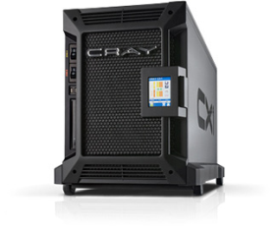
Traditional Password Storage
($\text{jblocki}\text{,}\text{123456}$)
Username
jblocki
Salt
89d978034a3f6
Hash
85e23cfe0021f584e3db87aa72630a9a2345c062
SHA1(12345689d978034a3f6)=85e23cfe0021f584e3db87aa72630a9a2345c062
+
Notes:
Suppose that I register for an account at playstation.com

Slide 3
Offline Attacks: A Common Problem
Password breaches at major companies have affected billions of user accounts.
Notes:
Unfortunately, offline dictionary attacks are quite common. Password breaches at major companies have affected millions of users.

Slide 4
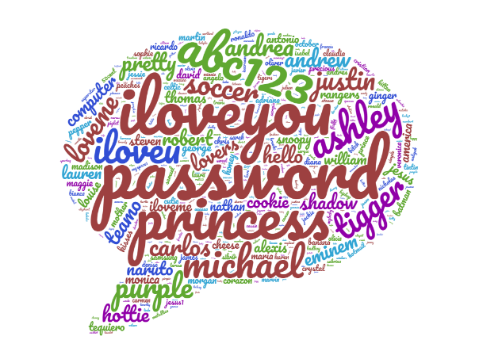
User Password Distribution
Challenge: Many user’s select weak passwords which are easy to guess.
Notation: $Pr⁡[pw]$ probability that a random user selects password $pw$
$λ\left(B\right)$: probability mass of top B passwords in real distribution (unknown)

Slide 5
Key Stretching
Hash Function | Cost: C
H
H^{k} | …
Memory Hard Functions
Hash Iteration

Slide 6
Rational Attacker
Attacker Goal: Maximize Profit
Expected Reward - Expected Guessing Cost
Attacker Tradeoff: Checking more passwords $B$ increases expected reward and expected guessing costs. Pick $B$ to maximize profit.
Defender Goal: Minimize number of cracked passwords
Higher Guessing Costs ➔ Attacker cracks fewer passwords
Dependent on
Value of cracked pwds ($v$)
User password distribution $λ\left(B\right)$
Dependent on
Hash cost parameter $k$.
User password distribution

Slide 7
A Fundamental Tradeoff
Increased Costs for Honest Party and Attacker
Notes:
One proposed defense is to intentionally make the cryptographic hash function more expensive to evaluate by using a cryptographic hash function like BRCRYPT or sCrypt. The tradeoff is that making the hash function more expensive to evaluate increases costs for the adversary and a legitimate server.
Note: This slide could be skipped if the presentation is too long.

Slide 8
A Fundamental Tradeoff
Is the extra effort worth it?
Notes:
One proposed defense is to intentionally make the cryptographic hash function more expensive to evaluate by using a cryptographic hash function like BRCRYPT or sCrypt. The tradeoff is that making the hash function more expensive to evaluate increases costs for the adversary and a legitimate server.
Note: This slide could be skipped if the presentation is too long.

Slide 9
A Key Observation
password
Many passwords so weak that they will be cracked even if the hash cost $k$ is very large
password 12345
letmein abc123
…. ……
unbreakable princess
…. ……

Slide 10
A Key Observation
password
Some passwords are strong enough that they won’t be cracked even if hash cost $k$ is smaller
3Fi4 }9n8(881ngP
SwinglineDragonflySnowflakeBanana
FootballBoatPandaFlorida
…. ……

Slide 11
A Key Observation
password
Marginal Passwords: Increasing guessing cost $k$ will impact attacker’s decision
vs
3Fi4 }9n
Darlingz31707
FootballBoatPanda
SwinglineDragonfly538
…. ……
vs
vs
vs

Slide 12
Our Solution: DAHash
Defender Goal: Minimize % passwords cracked by rational attacker subject to amortized workload constraint
Key Idea: Guessing costs should depend on the strength of the password
DA = Distribution Aware
password
12345
SwinglineDragonfly538
FootballBoatPanda
SwinglineDragonflySnowflakeBanana
3Fi4 }9n8(881ngP

Slide 13
DAHash account creation
($\text{jblocki}\text{, }\text{pw}\text{=123456}$)
Store $\left(jblocki, salt, h\right)$
Discard $k$
$$h←H(pw,salt;k)$$
$salt←{\left\{0,1\right\}}^{L}$
$k$=getHardness($\text{pw}$)
$$\$$$
Hardness parameter is a function of the password

Slide 14
DAHash authentication
($\text{jblocki}\text{, }\text{pw}\text{′=654321}$)
$$h≠h′$$
Fail
$$h′←H(pw′,salt;k′)$$
retrieve user’s record
$$(jblocki, salt, h)$$
$k′$=getHardness(pw’)
If $\text{pw}\text{′=}\text{pw}$ then $k^{′}=h$ and authentication succeeds
If $\text{pw}\text{′=}\text{pw}$ then $k^{′}=k$

Slide 15
Our Contributions
DAHash Mechanism
Stackelberg Game Model
Efficient greedy algorithm to compute attacker’s best response
Optimization problem to tune DAHash cost parameters
Inputs: server workload constraint, password distribution and (an estimation of) the value of a cracked password
Experimental Evaluation
9 datasets
Empirical distribution (when value $v$ is small)
Monte Carlo distribution (when value $v$ is larger)

Slide 16
Stackelberg Game Model (Server)
The server (leader) moves first
Selects hash costs vector $\vec{k}=\left(k_{1},k_{2}⋯k_{τ}\right)$--- hash cost for each strength group
Cost to check password $pw$ is $k_{i}$ where $i=getHardness(pw)$ is generated by a password strength model
Amortized Workload Constraint:
$$\sum_{i=1}^{τ}{\operatorname{Pr}\left[getHardness\left(pw\right)=i\right]k_{i}≤C_{max},}$$
(Optional) Fairness Constraint: $k_{i}≥k_{min}$ e.g., $k_{min}=\frac{C_{max}}{10}$
Probability a random user’s password receives hash cost $k_{i}$

Slide 17
Stackelberg Game Model (Attacker)
The attacker (follower) moves next
Knows password distribution and can compute $getHardness(pw)$
Selects an ordering $π$ over passwords in his dictionary and a budget $B$
Guesses first $B$ passwords in permutation $π$ and then stops
Attacker success rate $P_{ADV}=λ\left(π,B\right)$, where
$$λ\left(π,B\right):=\sum_{i=1}^{B}{Pr⁡[{pw}_{π(i)}]}$$

Slide 18
Attacker’s Utility
Suppose that the attacker plays action $(π,B)$
checks top $B$ passwords in permutation $π$ and then stop
Utility
$U_{ADV}\left(v,\vec{k},\left(π,B\right)\right)=v$ $λ\left(π,B\right) − \sum_{i=1}^{B}{\left(1−λ\left(π,i−1\right)\right)k({pw}_{π(i)})}$
Rational Attacker Maximizes Utility
$$\left(π^{∗},B^{∗}\right)={argmax}_{π,B}{ U}_{ADV}\left(v,\vec{k},\left(π,B\right)\right)$$
Expected cost
Expected gain
Probability that the first $i−1$ guesses are wrong
Cost paid for $i$th guess

Slide 19
Defender’s Utility
Goal: Minimize % of cracked passwords subject to constraint that rational attacker responds optimally.
Server utility $U_{SRV}\left(v,\vec{k}\right)=−λ\left(π^{∗},B^{∗}\right)$ where
$$\left(π^{∗},B^{∗}\right)={argmax}_{π,B}{ U}_{ADV}\left(v,\vec{k},\left(π,B\right)\right)$$
Task: Find $\vec{k}$ maximizing utility (minimizing % cracked passwords) subject to feasibility constraints (server workload).
First Step: Given $\vec{k}$ compute attacker’s optimal response $\left(π^{∗},B^{∗}\right)$.
Challenge: Exponentially many orderings $π$ to check
% Cracked passwords when attacker responds rationally
Given $\vec{k}$ attacker responds with utility maximizing strategy

Slide 20
Optimal Strategy for Attacker
``bang for buck” → probability that password is correct normalized by guessing cost for that password
Define $r_{π(i)}=$ $\frac{Pr⁡[{pw}_{π(i)}]}{k({pw}_{π(i)})}$
We say a checking sequence $π$has an inversion with respect to $\vec{k}$ if for some pair $a>b$we have $r_{π\left(a\right)}>r_{π\left(b\right)}$
Theorem: $π^{∗}$ does not contain inversions
We checked password ${pw}_{π(b)}$first even though the bang for buck ratio is higher for password ${pw}_{π(a)}$
Intuition: swapping the order of ${pw}_{π(b)}$ and ${pw}_{π(a)}$ will increase attacker’s utility
Notes:
Add some pictures to illustrate

Slide 21
Optimal Strategy for Attacker
``bang for buck” → probability that password is correct normalized by guessing cost for that password
Define $r_{π(i)}=$ $\frac{Pr⁡[{pw}_{π(i)}]}{k({pw}_{π(i)})}$
We say a checking sequence $π$has an inversion with respect to $\vec{k}$ if for some pair $a>b$we have $r_{π\left(a\right)}>r_{π\left(b\right)}$
Theorem: $π^{∗}$ does not contain inversions
Greedy Algorithm --- sort passwords by “bang-for-buck” ratio $r_{π(i)}$in descending order to find $π^{∗}$
Loop over all possible values of B to find $B^{∗}$
Tricks to improve efficiency given compact representation of distribution
Notes:
Add some pictures to illustrate

Slide 22
Optimizing Hash Costs (Server)
Inputs: $v$, $C_{max}$ and $k_{min}$ (also $getHardness()$ and password distribution)
Variables: Cost parameters $k_{1},…,k_{τ}$
Outputs: ${\vec{k}}^{∗},U_{SRV}\left(v,{\vec{k}}^{∗}\right)$
Goal: Minimize attacker’s success rate
$$m\text{in} λ\left(π^{∗},B^{∗}\right)$$
s.t.
$${U_{ADV}\left(v,{\vec{k}}^{∗},\left(π^{∗},B^{∗}\right)\right)≥U_{ADV}\left(v,\vec{k},\left(π,B\right)\right), ∀\left(π,B\right), \atop \begin{aligned}\sum_{i=1}^{τ}{\operatorname{Pr}\left[getHardness\left(pw\right)=i\right]k_{i}≤C_{max},} \\ k_{i}≥k_{min}, ∀i.\end{aligned}}$$
Attacker responds optimally
Server workload constraint
Minimum protection level (optional)

Slide 23
Empirical Password Distribution
We rely on 9 large password datasets: Bfield, Brazzers, Clixsense, CSDN, LinkedIn, Neopets, RockYou, 000webhost, and Yahoo!
Can view datasets as N independent samples from (unknown) distribution
E.g., Yahoo! frequency corpus based on N=70 million user passwords
Empirical distribution:
$$\hat{pi}≔ Pr\left[{pw}_{i}\right]= \frac{f_{i}}{N}$$
Advantages: Simple + accurate for small to moderate values v.
For moderately large guessing budgets B we have $λ\left(B\right)≈\hat{λ}\left(B\right)$
Disadvantage: Inaccurate results for larger values of v
Good-Turing Frequency Estimation: Highlight regions where $|λ\left(B\right)−\hat{λ}\left(B\right)|$ could be large
Frequency of ith most common password in dataset
Empirical distribution
Probability mass of top B passwords in real distribution (unknown)

Slide 24
Monte Carlo Password Distribution
We rely on 9 large password datasets: Bfield, Brazzers, Clixsense, CSDN, LinkedIn, Neopets, RockYou, 000webhost, and Yahoo!
Monte Carlo Distribution:
Subsample passwords from each dataset,
Extract guessing numbers from password guessing service
Fit distribution to guessing curve
Advantages:
Evaluate DAHash for larger values v.
Disadvantage:
If attacker develops more sophisticated model then we optimized DAHash parameters with respect to the wrong distribution
Neural Network, Markov Models, PCFGs, JTR, HashCat

Slide 25
Experiments
Fixing a password distribution D and DAHash parameters v and C_{max}
Optimize DAHash parameters
Defender uses blackbox optimization algorithm (BITEOPT) to solve optimization parameter
Compute the attacker’s best response and % cracked passwords
Repeat Steps (1-3) for different value to cost ratios v/ C_{max}
Plot % cracked vs. v/C_{max}

Slide 26
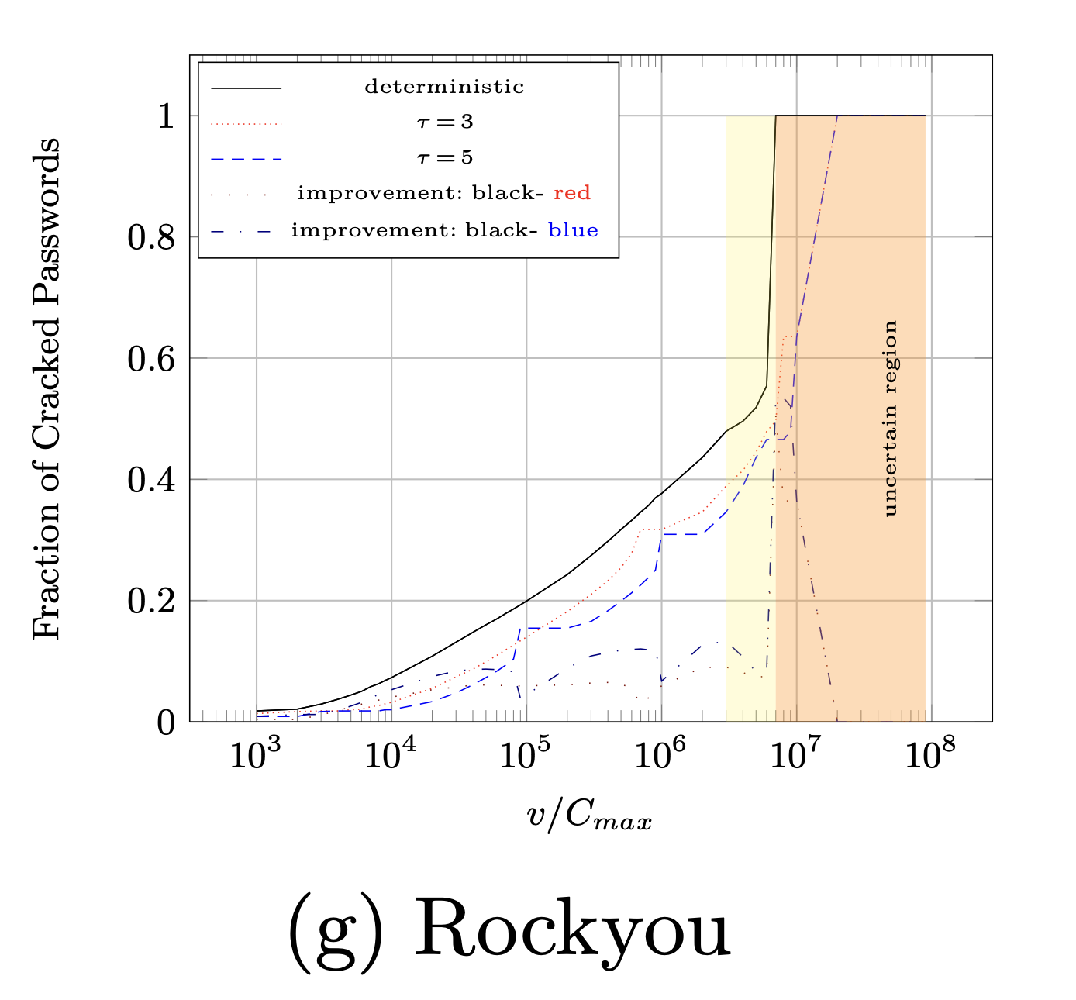
Results (empirical distribution)
Empirical Distribution might diverge significantly from real distribution (unknown)
Uncertain Regions Derived via
Good-Turing Frequency Estimation
13% improvement
13% improvement
5 strength groups
5 strength groups
3 strength groups
3 strength groups
Baseline: No DAHash
Constant cost
Notes:
, explain x-axis and y-axis and Highlight specific points on plot
Omit sup(E) >= 0.1

Slide 27
Results (empirical distribution)
15% improvement
Notes:
, explain x-axis and y-axis and Highlight specific points on plot
Omit sup(E) >= 0.1

Slide 28
Cost Allocation (empirical distribution)
Protecting weak pwds
weak pwds fully cracked
all pwds cracked
Protecting medium pwds
Protecting strong pwds
medium pwds fully cracked
Notes:
Highlight a few points with animation

Slide 29
Results (Monte Carlo distribution)
Monte Carlo Distribution: Defined to fit guessing curve derived from sophisticated password cracking models
Advantage: Models attacker success rate for large values of $v$.
Disadvantage: If attacker develops improved model the DAHash parameters may have been optimized with respect to the wrong distribution.
20% improvement

Slide 30
Conclusion: DAHash
DAHash focuses key-stretching effort on “savable” passwords
DAHash reduces the fraction of passwords that would have been cracked in an untargeted offline attack by up to 15% (resp. 20 %) under empirical distribution (resp. Monte Carlo distribution)
Compatible with memory hard functions
password
12345
SwinglineDragonfly538
FootballBoatPanda
SwinglineDragonflySnowflakeBanana
3Fi4 }9n8(881ngP

Slide 31
Thanks for Listening

Slide 32
Could DAHash harm weak passwords?
Concern: Could DAHash harm user’s with weak passwords?
Answer:
Weak passwords are granted more protection when $v$ is small and it is possible to deter an attacker from cracking them.
When $v$ is sufficiently large weak passwords are going to be creaked regardless of protection effort; better switch effort to “savable” passwords
Nevertheless, every password receives a minimum level of acceptable protection $k(pw)≥k_{min}$
Potential harm if our estimation of the attacker’s v is highly inaccurate e.g., we categorize a password as ``unsavable” too early.

Slide 33
What about Side-Channel Attacks?
Concern: Suppose a side-channel attacker observes how long it takes for a user to authenticate. Could DAHash leak information about the strength of the user’s password?
Answer: A naïve implementation of DAHash would leak information. In DAHash the cost k is linked to the strength of the user’s password and for key-stretching algorithms like BCRYPT and PBKDF2 the cost is directly proportional to the running time (#hash iterations).
Solutions:
Fixed authentication time e.g., 250 milliseconds
Delay response even if the hash function has already been computed
Use memory hard functions
Cost (k) is a function of space (s) and time (t) e.g., k=st
Can tune cost k by adjusting s while keeping the running time fixed.

